Slide 1


Java Backend Roadmap
Explore the essential Java concepts and tools for building robust backend applications. This roadmap covers the fundamental building blocks, frameworks, and testing approaches to become a proficient Java developer.
by Felizardo Caculo

Slide 2

Core Java Concepts
1
Data Types & Variables
Understand primitive and reference data types, variable declaration and usage.
2
Conditionals & Control Flow
Master if-else statements, switch cases, and looping constructs.
3
Memory Management
Explore Java's memory model, garbage collection, and object lifecycle.
4
Collections Framework
Utilize Java's powerful collection classes like ArrayList, HashMap, and HashSet.

Slide 3
Java Build Tools
Maven
Gradle
Ant
A popular build automation tool for managing project dependencies and build lifecycle.
A modern, flexible, and powerful build tool with a focus on developer productivity.
A XML-based build tool that provides a more manual approach to project management.

Slide 4
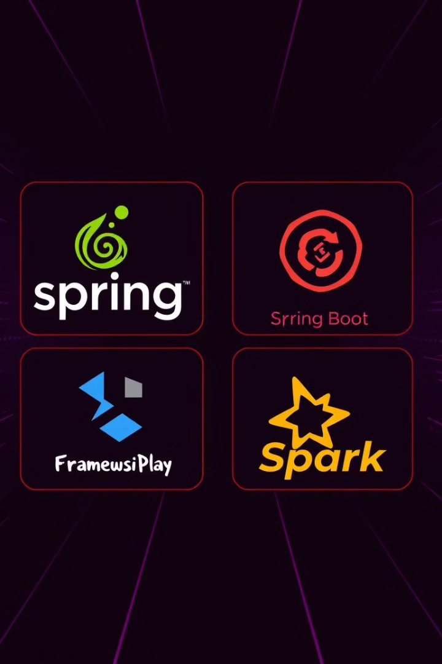
Java Frameworks
Spring
A comprehensive application development framework for building enterprise-level Java applications.
Spring Boot
An opinionated framework that simplifies the setup and configuration of Spring-based applications.
Play Framework
A high-productivity Java and Scala web application framework that follows the Model-View-Controller (MVC) architectural pattern.
Spark
A lightweight, Sinatra-inspired Java web framework that provides a simple and elegant DSL for building web applications.

Slide 5



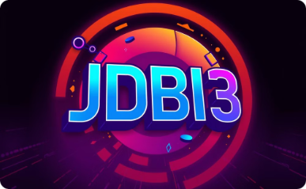
Java ORM Frameworks
Hibernate
Spring Data JPA
EBean
JDBI3
A powerful Object-Relational Mapping (ORM) framework that simplifies database interactions.
A Spring-based framework that provides a high-level abstraction for working with JPA-based data access layers.
A simple, fast, and powerful ORM framework that emphasizes developer productivity and ease of use.
A Java SQL toolkit that offers a fluent API for interacting with databases, without the overhead of an ORM.

Slide 6

Java Testing Frameworks
Unit Testing
Behavior-Driven Development
Utilize frameworks like JUnit and TestNG to write and execute unit tests for individual components.
Adopt frameworks like Cucumber-JVM and JBehave to write and execute behavior-driven tests.
1
2
3
Integration Testing
Leverage tools like REST Assured and JMeter to perform end-to-end integration testing of your application.

Slide 7
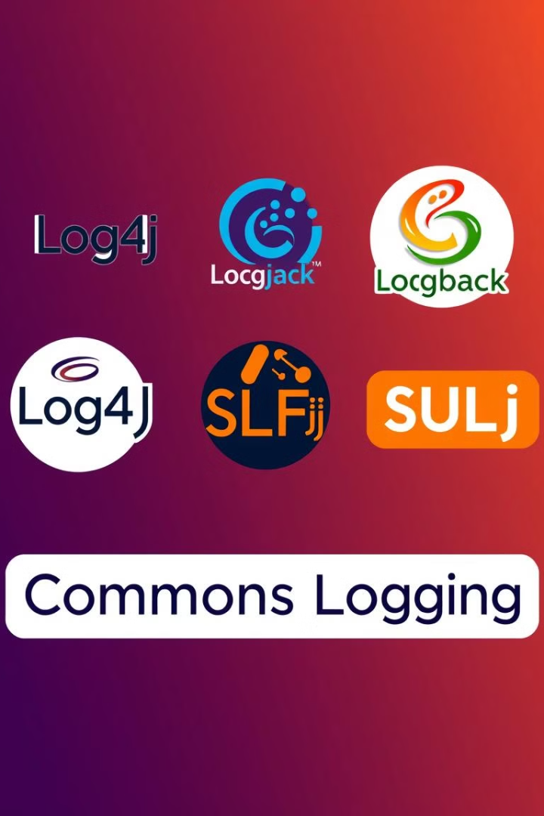



Java Logging Frameworks
TinyLog
A lightweight and easy-to-use logging framework for Java applications.
SLF4J
A logging abstraction layer that allows you to choose the actual logging implementation at runtime.
Logback
A powerful and flexible logging framework that is designed as a successor to the popular Log4j library.
Log4j
A widely-used logging framework that provides a rich set of features and configuration options.

Slide 8




Java Database Integration
JDBC
The Java Database Connectivity (JDBC) API provides a standard way to interact with databases from Java applications.
JDBC Template
A Spring framework component that simplifies JDBC-based data access, reducing boilerplate code.
Testing
Utilize tools like Cucumber-JVM and JBehave to write and execute behavior-driven tests for your Java applications.

Slide 9

Java Fundamentals
Language Syntax
1
Understand the basic syntax, including data types, variables, control structures, and object-oriented programming concepts.
2
JVM Internals
Explore the Java Virtual Machine (JVM) architecture, class loading, and the execution of Java programs.
Garbage Collection
3
Learn about Java's automatic memory management system and how to optimize garbage collection performance.

Slide 10

Java Testing Practices
Mocking
Use tools like Mockito to create mock objects and simulate dependencies for effective unit testing.
Behavior Testing
Adopt a behavior-driven development (BDD) approach using frameworks like Cucumber-JVM and JBehave.
Test Automation
Implement a comprehensive test automation strategy, including unit, integration, and end-to-end tests.

